Slide 1
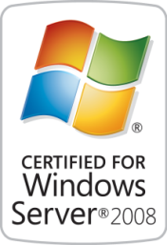
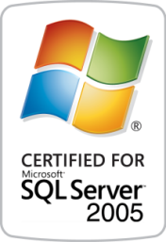
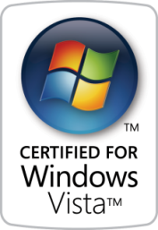

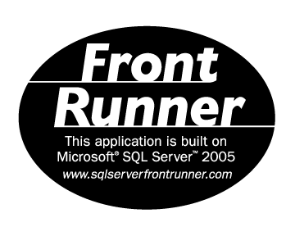


Solutions for Performance Driven Companies
Aras Innovator
enterprise PLM solution suite
Notes:
1

Slide 2
Agenda
Company Overview
Aras Innovator – high-level view
Aras Innovator – architectural view
Platform and Configuration
AML Concepts (i.e. How Modeling Works…)
Federation & Integration
Packaging
Upgrades

Slide 3
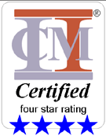

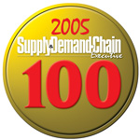

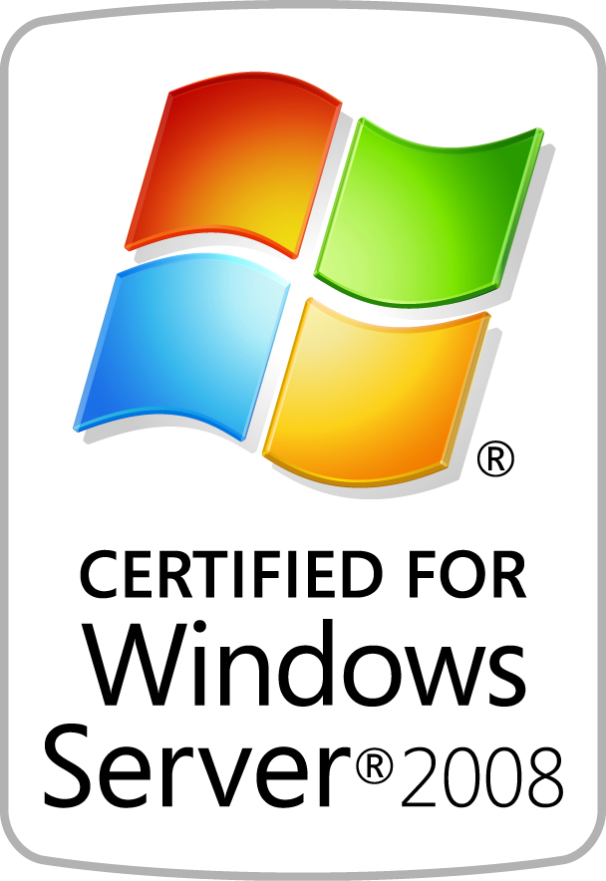
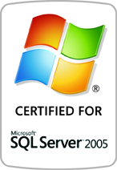
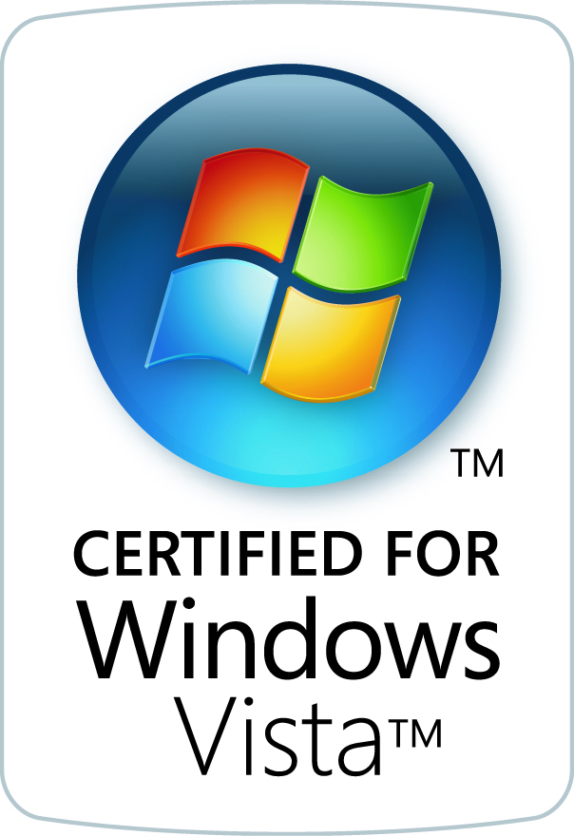
Aras Overview
Business: Enterprise Open Source Solutions
PLM
Program, Product and Project Management
Quality Compliance & Risk Management
Configuration & Change Management
Workflow / Enterprise BPM
PDM CAD Management
Quality Systems
Product: Aras Innovator ®
Technology: Advanced Model-Based SOA
Certifications: Microsoft Platform Certified

Slide 4
PLM & PDM Market Issues
Licensing model is wrong for the enterprise
Too expensive to achieve enterprise-wide collaboration
Lots of people need access, not just engineering
Product Management, Quality, Operations, Sourcing, Procurement
Suppliers, Outsourced Manufacturing, Outside Design & Engineering
Systems are difficult to use
Not flexible to model division-specific processes
Executives lack visibility
No Product Intelligence for business decisions

Slide 5
Why Aras
Founded 2000 by PDM/PLM Industry Veterans
Model-Based SOA Framework
Simplify PLM – most large-scale installations never get to production
Broaden PLM – historically too CAD focused, while companies need project management, quality, manufacturing, supply chain, and tooling
Easier to Configure - Modeling is a vastly simpler than programming
Enterprise Open Source Business Model
Because large up-front software purchases skew the Risk sharing
Improves the Relationship between customer and vendor
Leverages Value of a PLM Community for best practices exchanges

Slide 6









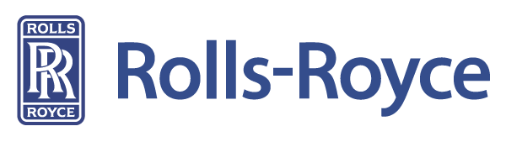




























Aras Customers + 400 world-wide installations / month

Slide 7





Enterprise Open Source
Microsoft Enterprise Open Source
No Software License Fees
Enterprise Production Ready
No Time-Outs, No User Limits
INCLUDED
Fast Growing PLM Community
Uses Microsoft Platform & Skills
Enterprise Class Support
No PLM License Fees
BENEFITS

Slide 8
Aras OSS Quick Facts
Switched to Open Source in Jan 2007
Use Ms-PL license for OS Projects
OSI certified
No contribution requirement
Freedom to use, modify, redistribute
Aras Innovator is freely available
No License Expenses
Enterprise Production-Ready System
Complete Access for Unlimited Users
Format is “Enterprise Open Source”

Slide 9
What is Enterprise Open Source?
Enterprise Open Source
Open Source
OSI compliant
No contribution requirement
Open Source Solutions
Flexible
Extendable
Collaborative
Source freely available to Everyone
Community Source
Binary download
Provides corporate security and control
Community Source Framework
Secure, Managed
Source available to Subscribers
Standard Commercial Platforms
Proven, Qualified
Enterprise Open Source combines multiple formats to provide corporations with the confidence and assurance necessary for business-critical solutions while delivering open flexibility for collaborative innovation.
It is ‘by business, for business’.

Slide 10







What is Enterprise Open Source?
Enterprise Open Source
Open Source Solutions
Flexible
Extendable
Collaborative
Source freely available to Everyone
Community Source Framework
Secure, Managed
Source available to Subscribers
Standard Commercial Platforms
Proven, Qualified
Enterprise Open Source format can use ANY commercial platform (or be multi-platform)
Oracle, IBM, Red Hat, Microsoft, etc. – Aras is enabled on Microsoft

Slide 11
Business Model
How Aras Makes Money
Subscription Model, Similar to Red Hat (NYSE: RHT)
Predictable Recurring Revenues from multi-year Contracts
Profitable, Scalable, Proven
Customer Benefits
Subscriptions Are Completely Optional
Eliminates Up-front License Capital Investment in Software Licenses
Predictable Annual Fixed Costs
Reduced / Balanced Risk
Subscription package does not restrict user access, customers always get unlimited user access

Slide 12

What Subscriptions Include
– Much More Than Maintenance –
Subscription Packages Include a number of benefits that are important for a business-critical enterprise software system
Monthly Service Packs
Security Updates, Hot Fixes
New Features & Capabilities
Microsoft Certified Version
Subscriber-only Solutions
Live Hotline and Online Support with Unlimited Incidents
Training class attendance included
System Upgrade Services included
► No other enterprise software provider includes Upgrades… Only Aras!
Slide 12

Slide 13
Agenda
Company Overview
Aras Innovator – high-level view
Aras Innovator – architectural view
Platform and Configuration
AML Concepts (i.e. How Modeling Works…)
Federation & Integration
Packaging
Upgrades

Slide 14

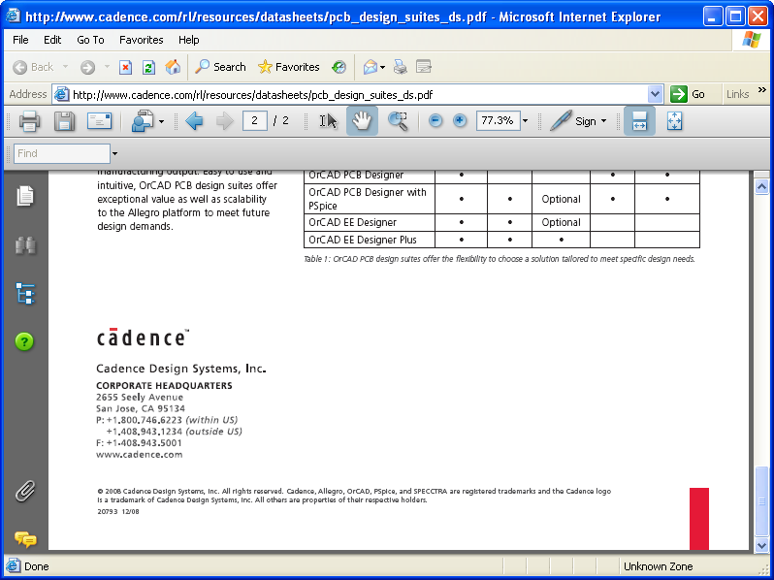




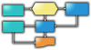
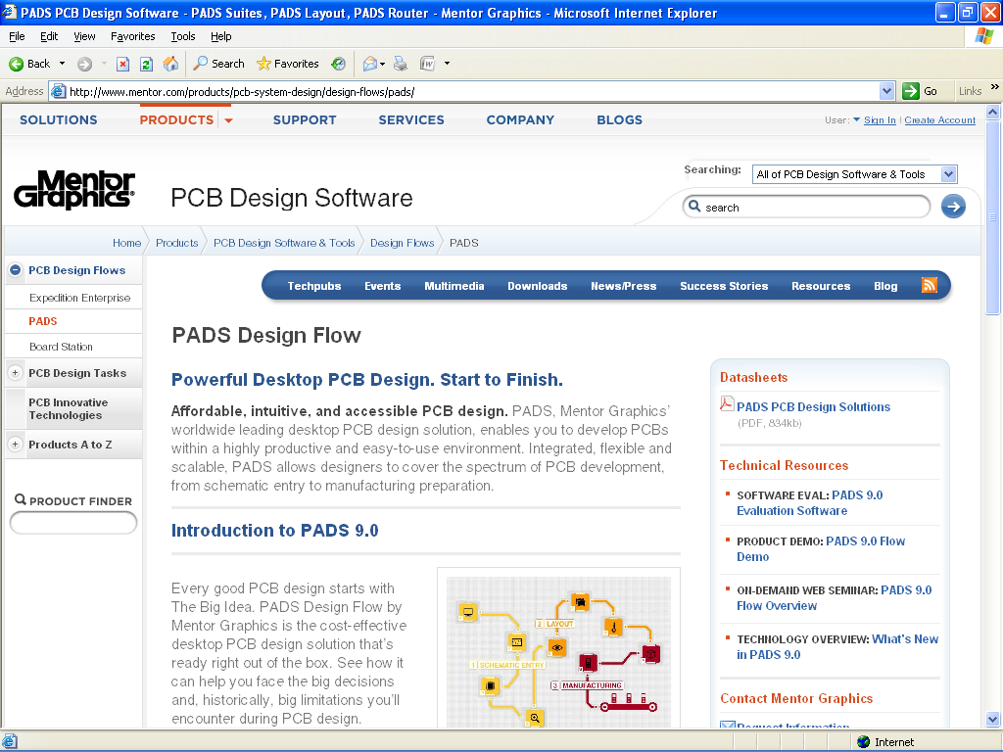

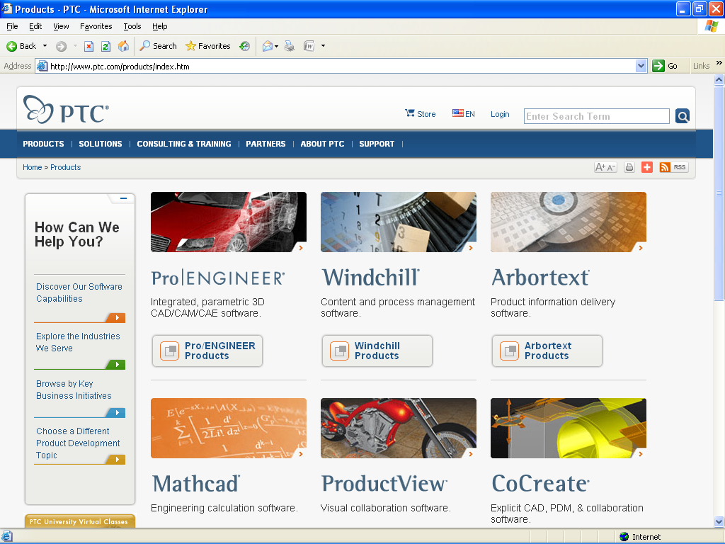


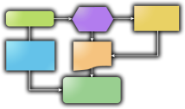
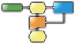
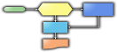
Aras Integrated Solutions
Concept
Design
Development
Launch
Manufacture
Support
Phase-based Program Management
Design
CAD/EDA
Document Mgt
File Vault
CMII Change Mgt
ERP
CAD / EDA
File Management
ERP
Connectors
“The Void”
No Visibility
No Repeatable Processes
Not Lean
Quoting Process
Requirements
&
Specifications
BOMs & Parts
AVL / AML
Qualified
Suppliers
Part
Approval
Reports &
Dashboards
FMEA
Process Flows
Control
Plans
CAPA
Corrective Actions

Slide 15
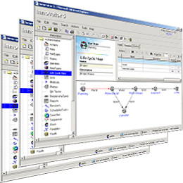


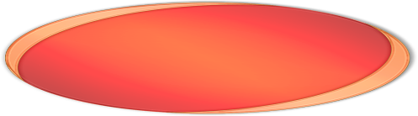
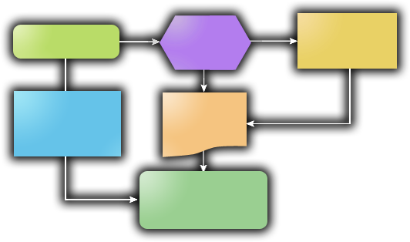


Aras Integrated Solutions
Aras Program Management
Phase-Gate Projects
Milestones & Deliverables
Traffic Light Risk Dashboards
PMI Project Templates
Enterprise Open Source Solutions
Download Includes:
3 Aras Certified Solutions
Program Management
Product Engineering
Quality Planning
Aras Product Engineering
Bill Of Materials [BOM], Product SKUs
File & Document Management
Change Management Workflows
Approved Vendor Lists [AVL/AML]
Aras Quality Planning
Risk Management
Failure Mode Effects Analysis [FMEA]
Control Plans
Action Item Closed-Loop
PLM Community Solutions:
Corrective & Preventive Actions
Training & Skills Tracking
Quality Systems
Tooling Management
Manufacturing Process Planning
Variant Configurator
CAD Integrations
http://www.aras.com/CommunityProjects
Notes:
The Aras Innovator enterprise open source download includes 3 Business Ready Solutions each with comprehensive functionality for…
CLICK 1
At a high-level
Aras Program Mgt includes Phase-Gate Project Mgt with Milestones & Deliverables, Traffic Light Risk Indicators and Dashboards, and project templates based on the PMI pjt mgt principles
The Aras Product Engineering solution includes functionality for managing complex configuration structures such as Bills of Material and Product SKUs
There are Document Management capabilities that can be used for any type of file format including Word Docs, Excel spreadsheets, PDFs, Images like TIFFs, multimedia files, and CAD drawings – I should mention that Aras Innovator is NOT an ‘in-process’ CAD file manager; it doesn’t have CAD integrations, however, it can be used to store CAD files it just doesn’t do parametric data extraction. [pause]
(if asked, “What’s the recommended way for dealing with CAD files” respond, “I don’t know what CAD packages your company uses, but most of them have a local CAD manager or PDM system. They really handle the ‘in-process’ activities well; that’s what they were designed to do. Aras will typically just integrate with that system if a company needs CAD data extraction.”
There are graphical Change Management workflows that can be used to control any of the documents or data in the system
And then there are other features like Approved Vendor / Approved Manufacturer Lists, part classification, substitutes & alternates, and a lot more
The Aras Quality Planning solution is used for Risk Analysis & Management
It’s got Failure Mode & Effects Analysis or FMEAs, both DFMEAs and PFMEAs, and then there are Process Flow Diagrams and Control Plans for mitigating any risks identified
And because Aras is a database driven system everything is tied together so that when you change data or add or delete items all the other related documents stay synchronized
Also, unique to Aras is the concept of Action Items for identified risks or RPNs over a specified threshold; they provide closed-loop issue resolution for accountability and certainty
CLICK 2
Also, because Aras is open source there are a growing number of Community Solutions available such as Corrective & Preventive Actions or CAPA issue management, RoHS environmental compliance, and things like Training & Skills Tracking and Customer Quoting. Projects are going on now around Integration Adapters for ERP systems and alternate clients such as Windows and Outlook access
All of this solution functionality and more is available, however, the Aras solutions are designed so that you can use as little or as much as you need. Functionality can be ‘turned off & on’ with user permissions. Everything is roles-based so users only see what they have permission to see.
In addition, the Aras solutions can be used as a stand-alone system or as an compliment to extend your existing enterprise systems

Slide 16
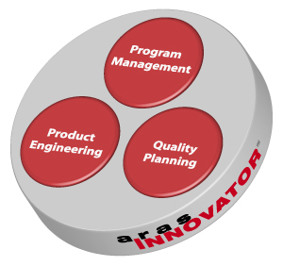
Aras Innovator®
Modern XML Web framework for building Engineering & Manufacturing Enterprise Systems
“Model-Based Service Oriented Architecture (SOA)” – Gartner
Downloads with 3 standard business-ready solutions, and access to a suite of community solutions
Aras Innovator is a SOA (Web Services) with 100% of functionality available through SOAP + XML

Slide 17
Aras Standard Solutions
Aras Program Management
New Product Project Portfolio
Executive Dashboards
Phase-based Programs
Milestones & Deliverables
Actions, Tasks, Activities
Project Templates
Aras Product Engineering
Bill Of Materials [BOM]
CMII Engineering Change
Approved Vendor Lists
Substitutes & Alternates
Design-to-Goal
Aras Quality Planning
Failure Mode Effects Analysis [FMEA]
Inspection & Test Control Plans
Process Flow Diagrams
Critical Part Characteristics
Comprehensive Functionality Simple Consistent Screens

Slide 18
Community Solutions
Requirements Management
ITIL
CMMI
Lean
Quality Systems
Environmental Compliance
Part and Lot Traceability
Incoming Inspection
Variant Configurator
Work Instructions & Routings
Training & Skills Tracking
Tooling Calibration and PM
CAD Integrations
ERP Integrations
. . .
Applying BPM, PLM and CM to Development, Quality, Manufacturing…

Slide 19
All Solutions based on Shared Services
Common Shared Services
Configuration Management
BPM
Classification
Access Control
Lifecycle State Management
Document Management
Activity Workflow
Dashboards
Reporting
Libraries and Templates
Federation
Versioning
Simplifies Development and Customizing

Slide 20
Agenda
Company Overview
Aras Innovator – high-level view
Aras Innovator – architectural view
Platform and Configuration
AML Concepts (i.e. How Modeling Works…)
Federation & Integration
Packaging
Upgrades

Slide 21


Model-Based SOA Technology Platform
Conventional Systems
Aras Innovator
Client
Client
Compiled Logic
XML Solution Models
Fundamentally
Different
Server Code
Web Services SOA
Files
Database
Files
Database
Real-Time Flexibility
Graphical Drag & Drop Real-Time Changes Without Complex Programming
Benefits
Guaranteed Upgradeability
Technology Separation Enables Quick & Easy Upgrades Without Impacting Customizations
Notes:
So, I’ve talked about the flexibility of the software… and there’s a reason that Aras solutions are significantly easier to customize than conventional legacy systems.
CLICK 1
It’s because Aras uses a unique and proven innovation that is fundamentally different than other systems. Aras combines a Web services service-oriented architecture with a Model-based approach.
Together the Aras technology delivers Unmatched Flexibility while achieving Unparalleled Upgradeability
Solution forms, workflows, lifecycles, and even the data schema can be changed in real-time with a graphical solution studio editor. The customization and creation of solutions is done at a business level with flow charts and forms not complex programming code.
This is important because it means solution customization can be done by regular people like power uses and business systems analysts instead of expensive consultants and programmers.
Aras has always had these capabilities, and now we’ve made it available as Microsoft Enterprise Open Source…

Slide 22










Model-Based SOA Enterprise PLM Architecture
Browser
Office Integrations
CAD
Connectors
Business Logic
Outlook
Word
Excel
SharePoint
.NET UI Components
Innovator Object Model
IOM
XML – SOAP Messages
Client Side
.NET Web Services
Open
Standards
Server Side
Business Logic
SOA
XML/SOAP
Business Objects & Processes
Web Services
Meta Data Management
Lifecycle Services
Workflow Services
Configuration Services
Classification Services
Search Services
Event Services
Security Services
Vaulting Services
Federation Services
Data Access Components
.NET Integrations
ADO
ODBC
Flat File
Direct API
O-R Mapping
Transaction Mgt
Cache
ADO.NET Data Access
Business Logic
Business Objects & Processes
Object Definitions
Aras File Vault
Process Definitions
System Definition

Slide 23
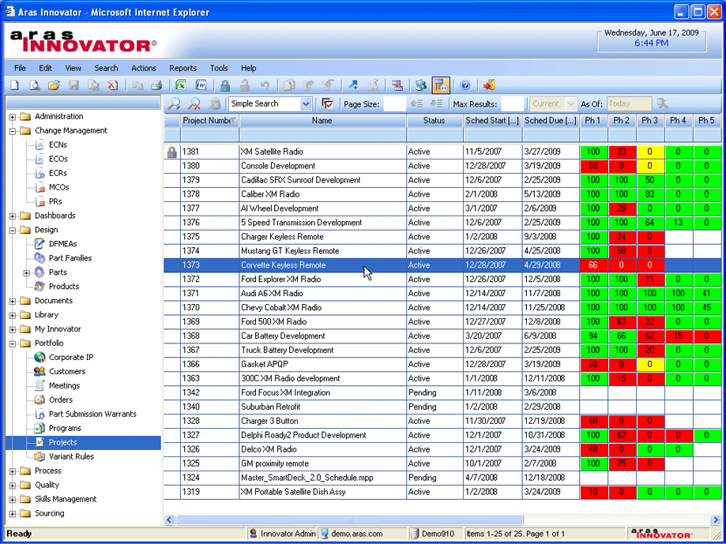
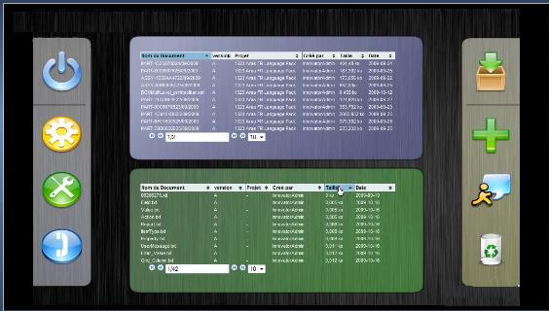
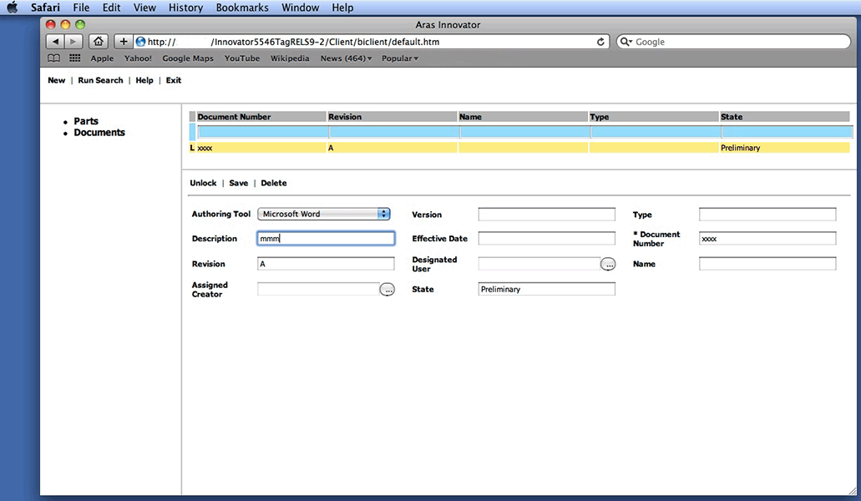
Model-Based SOA Client Technology
Office Integrations
CAD
Connectors
Outlook
Word
Excel
SharePoint
Innovator Object Model
IOM
Aras Standard Client is IE-only using .NET technology for drag-n-drop / graphic UI
Source code for clients using browser-independent Ajax is available
Embedded Aras Innovator IOM inside Office, SharePoint and CAD applications
Sending / Receiving XML/SOAP makes a client
XML – SOAP Messages
Client Side

Slide 24



Web Architecture
Access from outside the Firewall
Network Recommend 100 mbps network – Minimum 256 k (fractional T1) between Application Server and Clients
Recommend dedicated sub-LAN of 100 mbs or 1.0 GB copper between the Application Servers and Database Server
Browser Requirements:
Internet Explorer 6 +
Microsoft .Net 2.0 +
Must allow signed ActiveX controls /scripts (browser security settings)
.Net Security Policy must be configured
http or https
Internet
Internal Clients
DMZ
Reverse Web Proxy
Firewall Tunnel
CAD Connectors
CAD
ERP …
single port communication
Windows 2003 or 2008 Servers
…can run on single “Box”
Server Requirements
IIS 5 or higher
Innovator Server software installed, with IIS virtual directory set up
Microsoft 2.0 +
Microsoft SQL Server (2005)
Share Point Server
File Vaults
ARAS Innovator Apps & Microsoft IIS
Microsoft SQL Server Database

Slide 25

Model-Based SOA Configuration Options
Single Server for Initial Deployment / Small Scope
~ 200 users
Multiple Servers for scalability
~ 2,500 users
Distributed Servers for performance over
the corporate WAN & large scale deployments
Site 3
Innovator Client Cache
Web Server
Site 1
Site 2
Innovator Server
Aras Vault Server
Aras Vault Server
Innovator Server
Aras Vault Server
HQ
SQL Server
SQL Server
Innovator Server
Single Server:
Innovator Server
Vault Server
SQL Server
Multiple Servers:
Innovator Server
Vault Server
SQL Server
Distributed Servers:
Innovator Server(s)
Vault Server(s)
SQL Server

Slide 26
Model-Based SOA Benefits
Aras Innovator’s Model-Based SOA Framework Enables Real-Time, Transportable Business Data Model Changes
Agility – Rapid tailoring of forms, schema, access, lifecycles, workflows, behaviors,…
Commonality – All objects inherit the common classification, lifecycle, workflow, effectivity, and behaviors
Adaptability – Greatly simplifies the tailoring and interfacing tasks allowing a more fluid IT systems development process that can track with business changes, not lag behind them
Portability – Packaging of applications allows transportation of new solutions and solution extensions as XML files
Low Cost – Open standards and MS platform reduce infrastructure costs by 10x over Oracle/J2EE infrastructure

Slide 27
Agenda
Company Overview
Aras Innovator – high-level view
Aras Innovator – architectural view
Platform and Configuration
AML Concepts (i.e. How Modeling Works…)
Federation & Integration
Packaging
Upgrades

Slide 28
Anatomy of a Solution
Solutions are a collection of items that define features, behavior and functionality. In Innovator, these Item templates are known as “ItemTypes”.
In Object Oriented programming terms, the ItemType is similar to the class definition, and “Items” is used to refer to the class instances (objects) that are created from it.
Some of Innovator’s core ItemTypes include:
actions, forms, properties, reports, methods, workflow and lifecycle maps, relationships, permissions, user and identity management, etc.
Application developers create user-defined item types:
examples: ECN, ECR, BOM, Part, Supplier, Tool, etc.

Slide 29
Modeling Sandbox
99+% of Customizing and Integration work is inside the Modeling environment
Scripting / programs contained in Methods, source code goes in the database
Extending web services or modifying web services is supported by Modeling
Client, Server and Database events (triggers) are all acceptable points to model business rules

Slide 30
The Item Abstraction
Everything in Aras Innovator is an Item:
Which is an instance of an ItemType
Which itself is an Item
[ Aras Innovator is a 100% self describing system ]
➔ Result: the core framework code base is very small
Items may have relationships to other Items:
Items have structure (configurations)
Relationships are defined by RelationshipTypes
Which has three properties to define the RelationshipType rule:
source (parent) Item
related (child) Item
relationship (described-by) ItemType
RelationshipTypes are also ItemTypes
Can be sources of other relationships

Slide 31
Table Structure
classification
config_id
created_by_id
created_on
css
current_state
generation
history_id
id
is_current
is_released
keyed_name
locked_by_id
major_rev
managed_by_id
minor_rev
modified_by_id
modified_on
new_version
not_lockable
owned_by_id
permission_id
state
ItemTypes map directly to Tables
ItemType Name = Table Name
Each Item is a row in the table
Properties are the columns
In addition to User Definable Properties there are 23 standard Properties (columns) that describe every Item
Schema is open and published
Reporting, Analytics, and Data Batch Loading can done safely at the SQL table level
Slide 31

Slide 32
Table Structure
Each RelationshipType
Has a companion is_relationship ItemType to store the relationships Items
In addition to the 23 standard columns (properties) there
are additional properties to describe the relationship
source_id – the parent
related_id – the child
relationship_id – the Item that describes the relationship
Plus the behavior property defines the Configuration Management rule for the relationship
Fixed
Float
source_id
related_id
relationship_id
behavior
Slide 32

Slide 33
Pause….
Slide 33

Slide 34
Aras Innovator® Basics Items
ItemType
(ie. a business object)
Item (ie. an instance)
“Supplier”
Is_Versionable
Name
Telephone
Rating
…
Lockheed
978-794-7643
A+
Behaviors
Properties
Default Lifecycle
Form
Current State pointer
Lifecycle
View 1
Slide 34
Notes:
This slide lets you explain the capabilities of each of our application templates.
Each time you click a different application box will appear.
Note: the next slide helps you explain our unique core framework, why its different and how it enables low TCO.

Slide 35
Aras Innovator® Basics Relationships
ECN ItemType
ECN 10001
Description
Effectivity
Originator
…
AFFECTED PARTS ItemType
RelationshipType
PART ItemType
Field
Fin Goods
Raw
WIP
Fix / Float
PART XMR001
Description
Effectivity
Originator
…
Generation
Major_Rev
Minor_Rev
Slide 35
Notes:
This slide lets you explain the capabilities of each of our application templates.
Each time you click a different application box will appear.
Note: the next slide helps you explain our unique core framework, why its different and how it enables low TCO.

Slide 36
Aras Innovator® Basics Identity Membership Management
Group Identity2
Member
Group Identity1
Business Item
Part 123
Member
User Identity
“Need-to-Know”
List
Alias
Logon User
Permissions
Engineers – G,U
Purchasing – G
Ron Regan – G,U,D
Creator – G,U,D,C
Owner – G,U
Manager – G,U,C
Slide 36
Notes:
This slide lets you explain the capabilities of each of our application templates.
Each time you click a different application box will appear.
Note: the next slide helps you explain our unique core framework, why its different and how it enables low TCO.

Slide 37
Aras Innovator® Basics AML
Data and Transactions coded similarly
Simple syntax
100% of the Client ← → Server traffic is AML
100% of all transactions, interfaces, or actions can be expressed in AML
Slide 37

Slide 38
Aras Innovator® Basics Mapping Model to AML
ECN ItemType
ECN 123456
Description
Effectivity
Originator
…
AFFECTED PARTS ItemType
RelationshipType
PART ItemType
Field
Fin Goods
Raw
WIP
Fix / Float
PART 909011
Description
Effectivity
Originator
…
Generation
Major_Rev
Minor_Rev
Slide 38
Notes:
This slide lets you explain the capabilities of each of our application templates.
Each time you click a different application box will appear.
Note: the next slide helps you explain our unique core framework, why its different and how it enables low TCO.

Slide 39
Aras Innovator® Basics Mapping Model to AML
Client Requests
<Item type=‘ECN’ action=‘get’ levels=‘1’>
<item_number>ECN-10001</item_number>
</Item>
<Item type=‘ECN’ id=‘A0019BF5D’>
<item_number>ECN-100001</item_number>
<description>This is an ECN</description>
<Relationships>
<Item type=‘Affected Parts’>
<related_id>
<Item type=‘Part’ id=‘9810AB89DE’>
<item_number>XMR-001</item_number>
</Item>
</related_id>
</Item>
</Relationships>
</Item>
Server Response
Slide 39

Slide 40
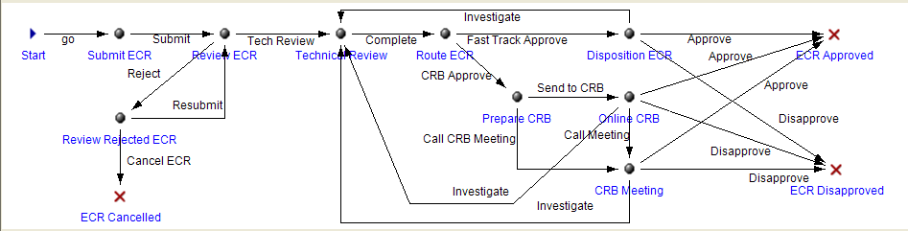
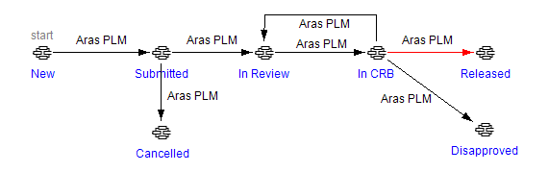
Project - Workflow - Lifecycle
Workflow Activity
People
Closed Loop
“Short” Activities
Email Notifications
ECN 123456
Description
Effectivity
Originator
…
Lifecycle State
Permissions
Integration Events
CM Behaviors
Email Notification
Slide 40

Slide 41
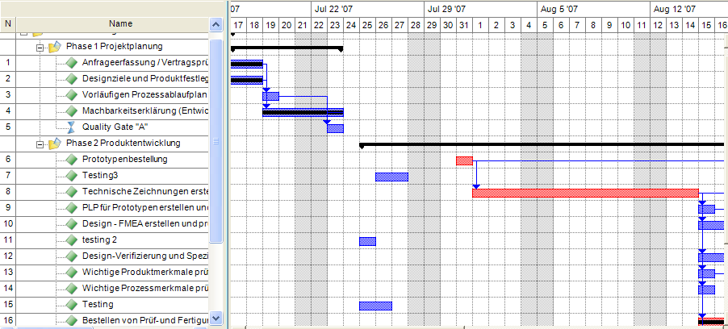
Project - Workflow - Lifecycle
Project WBS
Resource Planning
Long Activities
Scheduling
Many Deliverables
Email Notifications
Part AAG
Description
Effectivity
Originator
…
Workflow Activity
CAPA 893
Description
Effectivity
Originator
…
ECN 13456
Description
Effectivity
Originator
…
Lifecycle State
Slide 41

Slide 42
Project - Workflow - Lifecycle
Project WBS
Template is copied to create a unique
Project instance
Workflow Activity
Map is a template that is copied to create a unique
Process instance per Item Instance
All three work together…
… but it’s not a hard-coded hierarchy
Lifecycle State
All Item Instances Share one Map
Slide 42

Slide 43
Agenda
Company Overview
Aras Innovator – high-level view
Aras Innovator – architectural view
Platform and Configuration
AML Concepts (i.e. How Modeling Works…)
Federation & Integration
Packaging
Upgrades

Slide 44
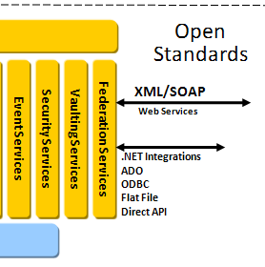
Federation
Federation is the process of connecting business objects in other systems, such that those business objects can be included in workflows, configurations and business rules
Federation is at “Lowest Level” of Architecture
Federate a complete ItemType, or just some Properties
Use an ItemType or Property to model the “foreign” data
All other Services and the Client will work with Federated data -- same as local data
Federation integration code normally in Methods
Web Services
SQL (ODBC)
Flat File exchange
Bind in API

Slide 45

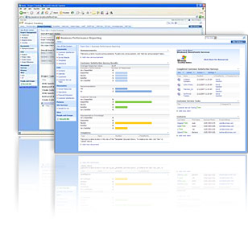

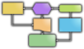


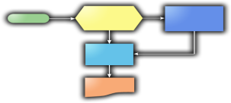
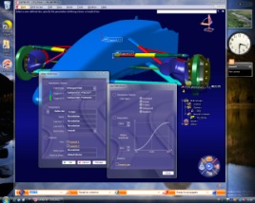
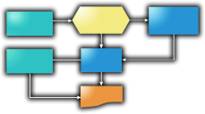

Integration / Rollout Strategy
Integrate To and Extend Existing PDM
Use Aras Web Services to Provide Full Featured Enterprise PLM Corporate-wide
Enterprise Open Source
Replace Existing PDM When Ready to Realize Even Greater Savings
Aras Model-Based PLM
SOA Approach
Full PLM Functionality
Windchill
IntraLink
eMatrix
CDM/VPM
Teamcenter
IMAN
Business Unit
Business Unit
Business Unit
Business Unit

Slide 46
Agenda
Company Overview
Aras Innovator – high-level view
Aras Innovator – architectural view
Platform and Configuration
AML Concepts (i.e. How Modeling Works…)
Federation & Integration
Packaging
Upgrades

Slide 47
Packaging
ItemTypes
Packages are complete solutions or incremental changes
Allows customizations to migrate from:
Dev -> Test -> Production
Allows “Open Source” exchange of solutions between companies
Package
“bom”
Methods
Forms
Relationships
Workflows
Export.exe
xml files
Import.exe
Target
Innovator
System

Slide 48
Agenda
Company Overview
Aras Innovator – high-level view
Aras Innovator – architectural view
Platform and Configuration
AML Concepts (i.e. How Modeling Works…)
Federation & Integration
Packaging
Upgrades

Slide 49
Upgrades Aras Release Process
Major release every ~ 9-12 months
Major releases are Open (except subscription-only utilities)
Distribution includes:
New MSI installer
Updated Code tree
Database image
Upgrade tools & Utilities (subscription-only)
Documentation (subscription-only)
Service Pack every 4-6 weeks
Service Packs are Subscription-only
Includes New Features, Bug Fixes, Security Updates
Designed to be Low-Impact (no major data model changes, lower risk)
Cumulative (can skip Service Packs)
Distribution includes:
New MSI installer
Updated Code tree
Database image
Upgrade tools to apply Service Pack
Documentation
Public Roadmap – Customer Driven

Slide 50
Upgrades Tools Perform Major Upgrades “In Place”
Code Tree
Create evaluation instance of DB and Code Tree
Analyze Model for customer changes to Aras standard Packages (core, PE, PM, QP,…)
Create Merge Package if necessary
Analyze Model for Method coding practices and API usage
Update Methods for new API functions if necessary
Add changes to Merge Package
Overwrite Code Tree with new Aras Innovator version
Import Upgrade and Merge Packages into Database
End User Testing and Validation
Repeat with Production Server
Web Services Programs Files
In IIS Virtual Directory
Database
Data
Models
Vaults*
* Note: Vaults are not affected by upgrade process

Slide 51
Upgrades Subscription Upgrade Process
Customer / Partner
Create database backup for Aras
Install new version of Aras Innovator code tree on test server
Participate in Merge analysis if required
Restore upgraded database from Aras Corp
Run end-user validation and testing
Aras
Receive database backup from customer
Setup upgrade environment and tools
Run analysis tools
Update methods and prepare merge package if necessary
Import upgrade and merge packages
Upgrade automation tool run-time is 1-12 hours depending on database size
Merge Package preparation requires interaction Aras – Customer – Partner
Heavily customized databases can be upgraded in 1 day, others in 1-3 weeks *
Subscription allows unlimited upgrades per year, but customer commits to code freeze and 4 week maximum time for each upgrade
* Consider this in the Implementation Approach

Slide 52
Agenda
Company Overview
Aras Innovator – high-level view
Aras Innovator – architectural view
Platform and Configuration
AML Concepts (i.e. How Modeling Works…)
Federation & Integration
Packaging
Upgrades
Next Steps?

